Slide 1
Statistic orientation
02116987 Kwon, jihun

Slide 2
Content
Parameter and Variable
Datatype
Representative value and Dispersion
Probability
Popular Distribution
Sampling
Hypothesis
Estimation
Several famous Test

Slide 3

Parameter and Variable
Population parameter (Greek)
ex) $μ$, $σ$…
Sample parameter (Alphabetic)
ex) x, s …

Slide 4
Parameter and Variable
Variable : Column’s name (Represent a character of data)
If data not change (0nly one category or type)
Constant

Slide 5
Statistical analytic method
Descriptive statistics
Inferential statistics
Data mining

Slide 6
Descriptive statistics
Basic way to get the insight

Slide 7
Representative value & Dispersion
Representative value
The value can represent the whole data
ex) mean, median, mode…
Dispersion (skewness, variance, kurtosis…)
Deviation (data – mean)
Error (observed – true value)
Residual (data - predicted)

Slide 8

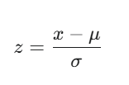
Ex) Standardization
Standardization is calculated by z-score way
Famous way to scaling the data using deviation

Slide 9
+) Analysis route
We need to figure out relationship between the data
Correlation (X <-> Y)
Cause and Result (X->Y)
We have to choose the way depends on those relationship and data type.

Slide 10
Data types
Data
Categorical
Nominal
Ordinal
numerical
internal
Ratio

Slide 11
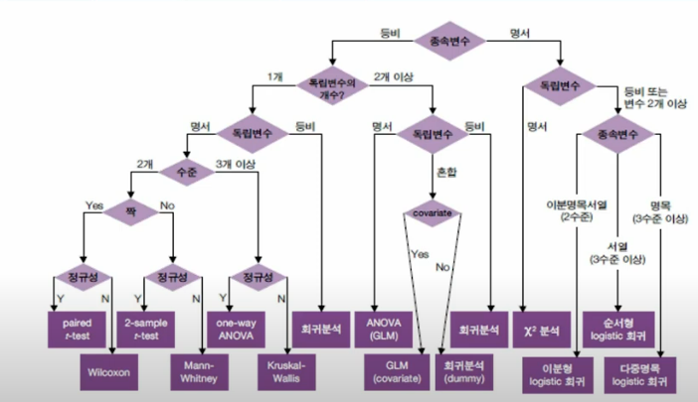
Method based on data type

Slide 12

Probability
$Probability = \frac{Number of Event}{Number of trial}$
In a same time => multiplication
P(A|B) = $\frac{P(A∩B)}{P(B)}$

Slide 13

Random variable, Probability Distribution
Random variable – probability to number
Discrete -> countable
Continuous -> Any value in the range?
Probability Distribution
Discrete -> sum(total) = 1 (for discrete variable)
Continuous -> $\int{total}$ = 1 (for continuous variable)

Slide 14
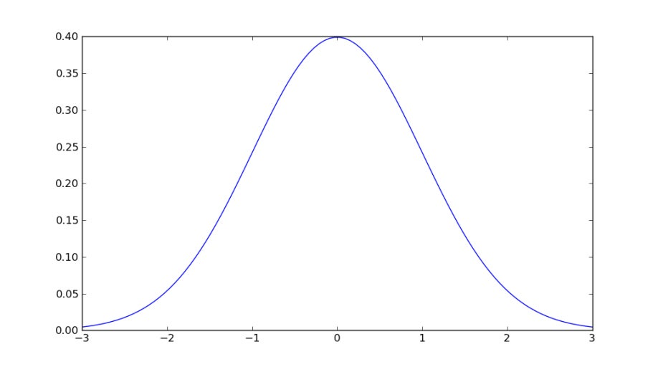
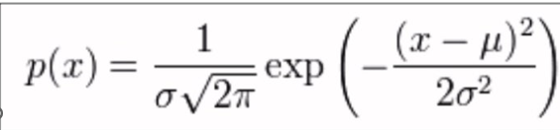


Normal Distribution (Gaussian distribution)
$C$entral limit theorem
If sample is big enough, they follow
the normal distribution
- $μ$ : positional parameter
$$\int_{μ−σ}^{μ+σ}{P(x) dx}$$
=> Probability of the event in deviation

Slide 15

*Why we not saying equideviation but equivariance
Since error between $σ$and s, we cannot say equi- thing -> calculate with variance (square value)
From that, we use the degree of freedom (Df) to figure out (depends on which method that we will use)

Slide 16

Other Distribution
Binomial Distribution
Distribution when try n times of Bernoulli trial.
- Mean : np | Variance = npq
Poisson Distribution
Distribution of the trial happen rarely
Mean = variance = m

Slide 17
Overvariance
If the case 1. clustered or have 2. unobserved factor, mean != variance
=> Negative Binomial Distribution

Slide 18
Sampling
Random sampling
Simple
Systematic
Stratified
Clustering

Slide 19
Sampling
Non-random sampling
Convenience
Purposive
Snowball
Quota

Slide 20
Estimation
Usually interval estimating ex) CI
Magnitude for deciding standard
Unbiasedness : (Expected estimation = population’s value)
Efficiency : how accurate and precision
Consistency : central limit theorem
Sufficiency : sample’s info usness of estimation

Slide 21
Hypothesis
H0 : Null hypothesis
H1 : Alternative Hypothesis
Basically, We assume the ‘NO’ for our guess and during the test, we try to found ‘Evidence’ of counter our NO.

Slide 22
Hypothesis
 | H0 | H1
H0 | Good(True positive) | Type 2 Error (False negative)
H1 | Type 1 Error (False Positive) | Good (True Negative)
In machine learning, similarly, we have confusion matrix
It is foundation of various index to evaluate the model
Additinoal H.W : find 3 of them
without overlap each other

